Slide 1

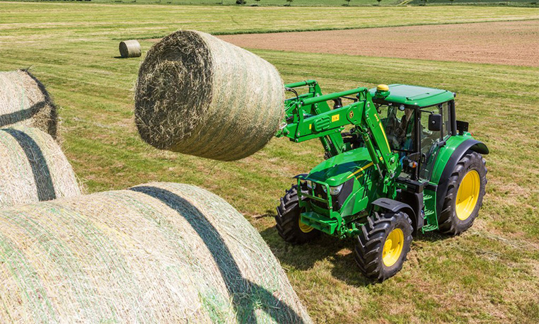
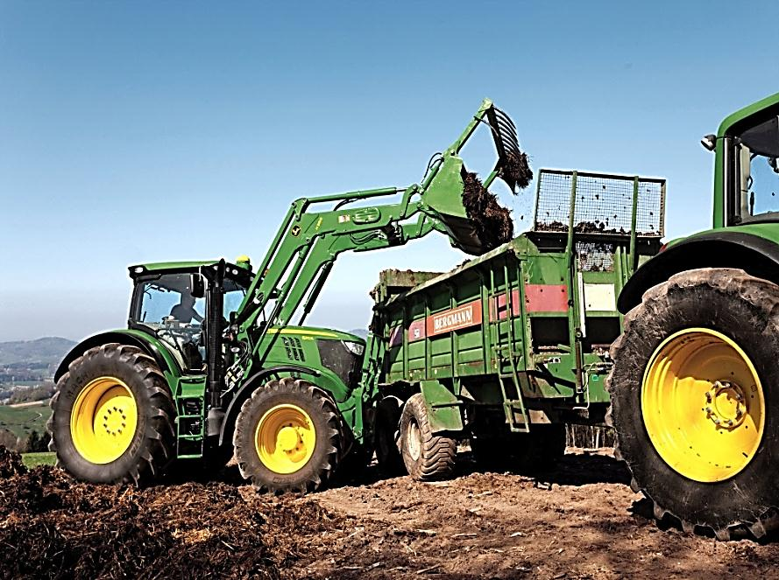
FOR PREVENTING ACCIDENTS AND TO WORK IN A SAFE WAY IT IS NECESSARY TO
Obligatorily use cabin or a safety frame
CROATIAN INSTITUTE FOR HEALTH
PROTECTION AND SAFETY AT WORK
Regularly clean the windscreen
Don`t remove protective gadgets and devices
Maintain brakes in good condition
Regularly check the tyre pressure
Regularly check the condition of hydraulics
Work in a safe way (manufacturer`s instructions)
SAFE WORK WITH TRACTOR
Image sources:
http://www.strompraha.cz/assets/gallery/254/4256.jpg
https://www.deere.co.uk/common/media/images/product/equipment/tractors/5e_series/r2/hero/r2b005138_762x458.jpg
https://i.ytimg.com/vi/6EaMfBtxWR0/maxresdefault.jpg
https://www.deere.co.uk/common/media/r2/images/products/equipment/tractors/6m_series/hero/r2d004738_762x458.jpg
https://www.osha.gov/SLTC/youth/agriculture/tractors.html
https://www.google.com/url?sa=i&rct=j&q=&esrc=s&source=images&cd=&cad=rja&uact=8&ved=0ahUKEwiG0f_I4s3RAhVDExoKHaFiCG0QjhwIBQ&url=http%3A%2F%2Fakshkumar.blogspot.com%2F2014%2F03%2Ftractor-full-notes.html&psig=AFQjCNH0Gz8k1QCa9ZvAUy_ZsWNp2xyF2Q&ust=1484899642174417
Series of Flyers
Education for Better Health Protection
and Safety at Work

Slide 2
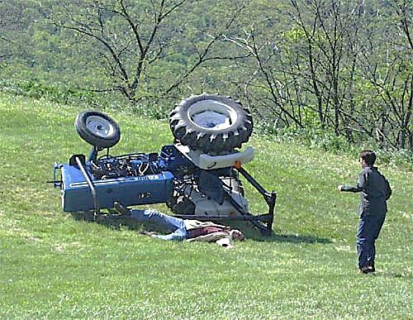
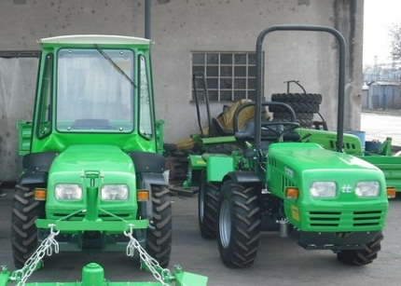
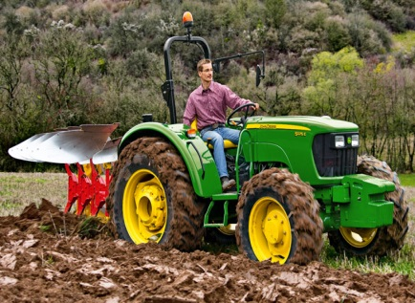

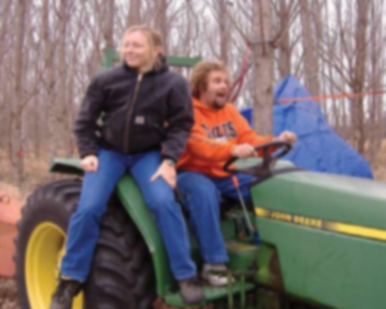
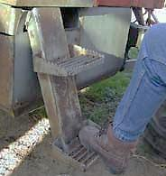
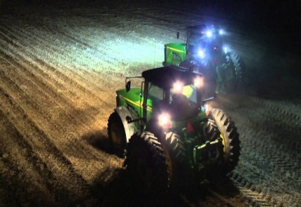
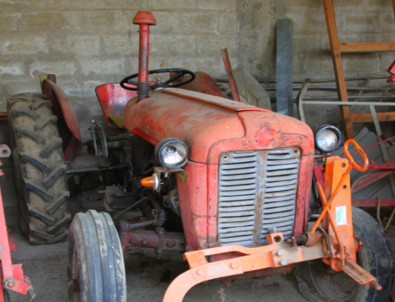
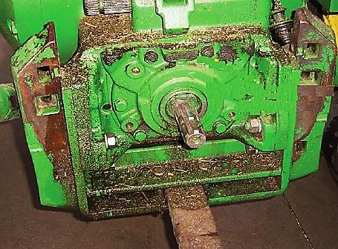
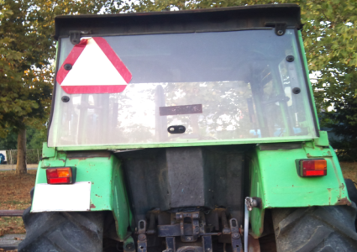
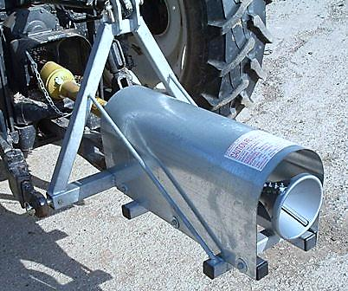
HOW TO WORK IN A SAFE WAY
THE MOST FREQUENT CAUSES OF ACCIDENTS WITH TRACTORS
Tractor should be maintained in good working order
Tractor should have a cabin or a protective frame
Tractor should be noticable when driven under bad visibility conditions (operational lighting and visible signs)
All the guards and protective devices should be in their place (attachment shaft etc.)
Safe approach to the driver`s seat should be enabled
Overestimating of personal
possibilities
Ignoring instructions for safe work with tractor
Hurry
Driver`s tiredness
Cabin or Safety Frame Obligatory
One Seat – One Person
Driver`s inexperience
Faulty tractor
It is Forbidden to
DO NOT:
Work with faulty tractor
Pour fuel and lubricate tractor, as well as repair it when the engine is started
Drunk driving
Jump into or jump out of the tractor, move over from tractor to attachment tools, stand on the drawbar or walk around when tractor is moving
Riding/Driving out of seat
Safe Access to Seat
Proper lighting
Drive without ROP
Work with unguarded PTO shaft
Obligatory Vehicle Marking
Tractor PTO Shield and PTO shaft guard

